Slide 1

Independent. Innovative. And always open source.
dotnetfoundation.org

Slide 2
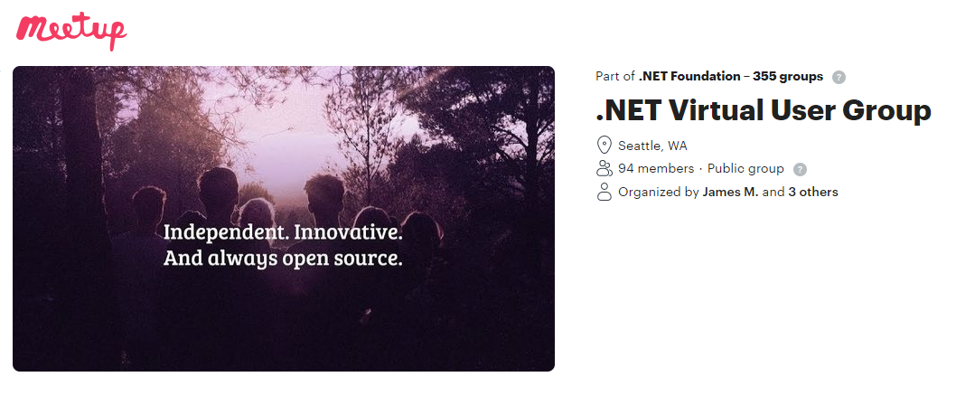
.NET Foundation Virtual User Group
Find virtual user groups happening around the globe!
meetup.com/dotnet-virtual-user-group

Slide 3
Azure Static Web Apps
“A modern web app service that offers streamlined full-stack development from source code to global high availability.”

Slide 4

Andreas Wänqvist
Voyado Tech Lead
Aurelia Core Team 2017➡
ex MSFT – Azure
@mobilemancer
www.linkedin.com/in/awanqvist/
mobilemancer.com

Slide 5
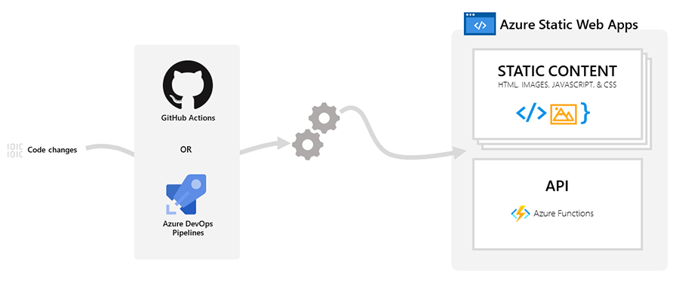
Azure Static Web Apps
Released in Preview at Build 2020
CDN hosting for static web content
Azure Function integration
GitHub integration for CI/CD
Staging versions
Supports custom domains
Auth provider integrations

Slide 6

CDN - Web Hosting for Static Content

Slide 7

API - Azure Functions
.NET Core 3.1 Python 3.8 Node 12
HTTP triggers only!
Notes:
The API route prefix must be api

Slide 8
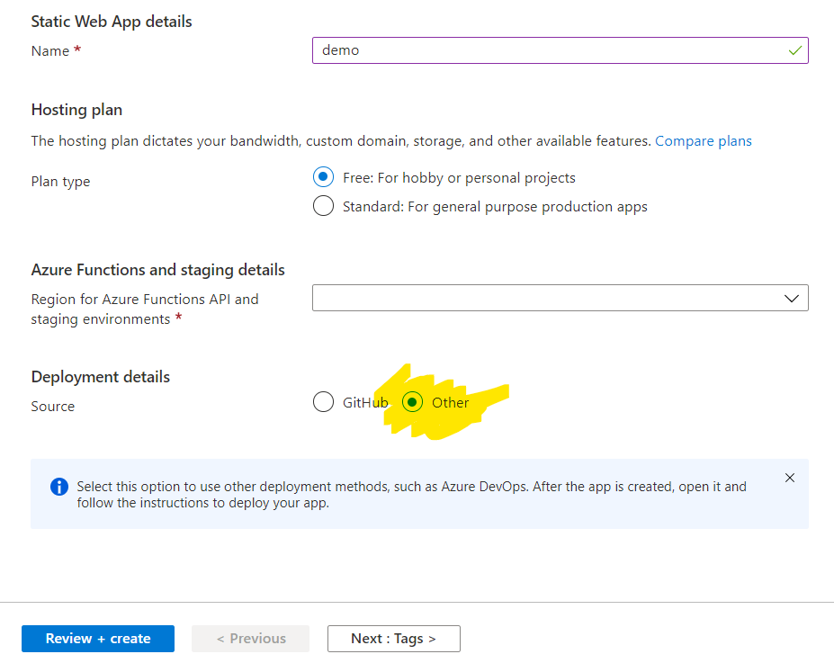
CI/CD – Azure DevOps
The app must be created from the Portal
Under the section “Deployment Details”
Choose “Other”

Slide 9
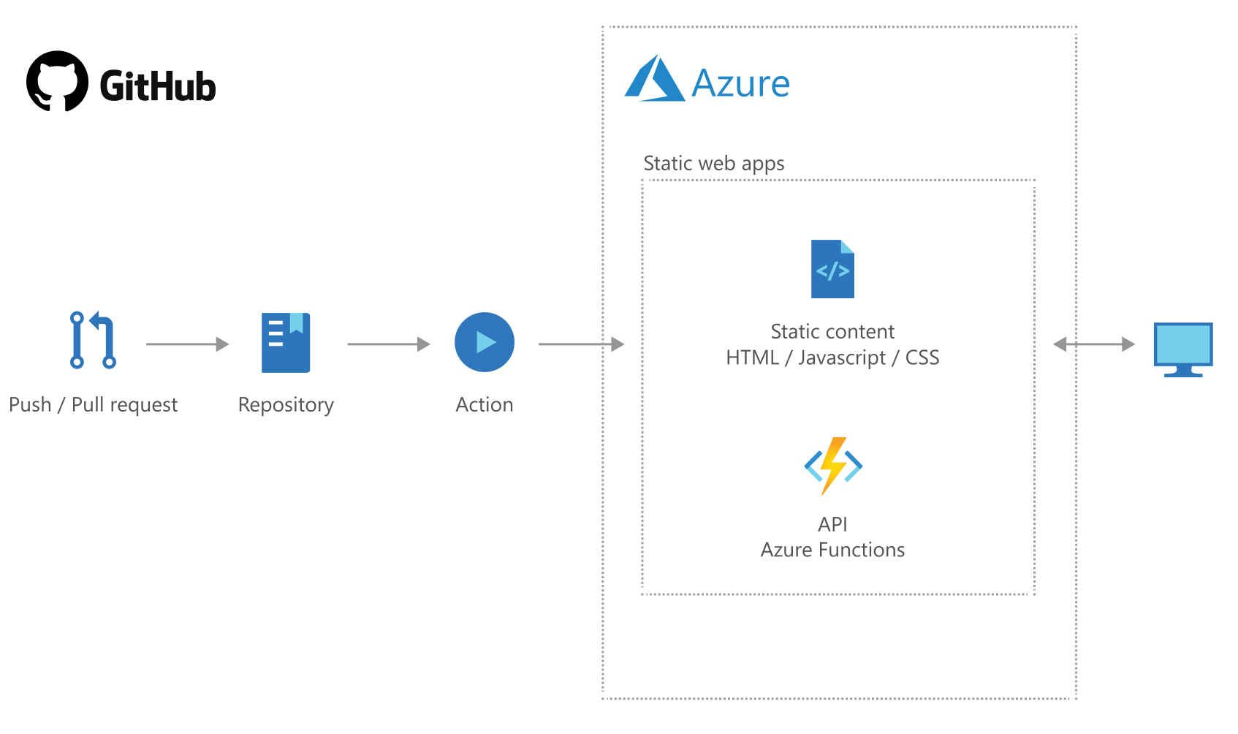
CI/CD - GitHub
GitHub Actions for CI/CD
Creates a Preview on PR

Slide 10
Staging Versions
Staging versions deployed automatically
Triggered with PR against main branch
Maximum 3 staging envs available
GitHub Dependabot creates PRs -> staging environments!!!

Slide 11

Custom Domains
Support for Custom Domains
Free SSL Certificate 🌟
Supports APEX domains!

Slide 12

Authentication Provider Integration
Azure Active Directory
GitHub
Twitter
(Facebook)
(Google)
All providers enabled by default!

Slide 13
MSFT Docs
“When you grant consent to an application as an end user, the application has access to your email address or your username depending on the identity provider.”

Slide 14
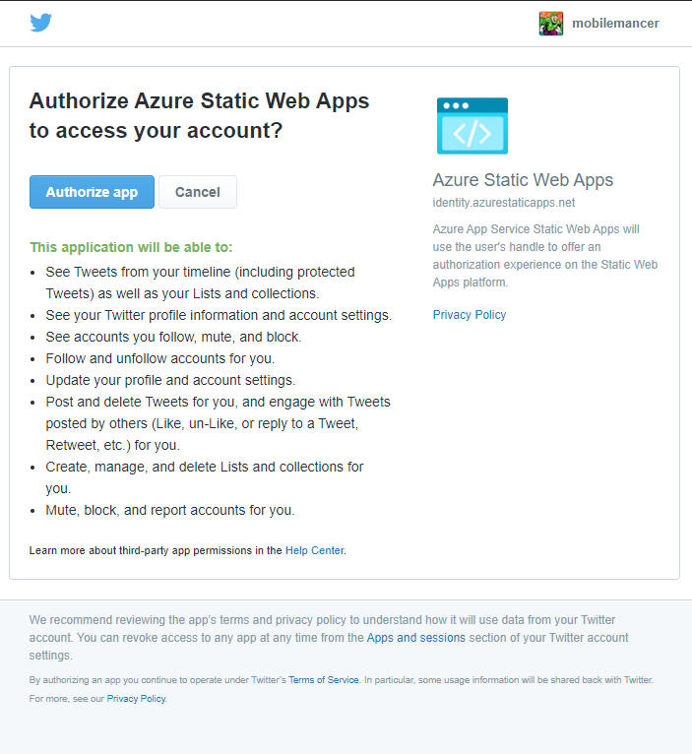
Twitter Auth Invite
🤯

Slide 15
Managing Auth
Managed through the Azure Portal
Possible to change roles after invite
Can remove users from the Portal
OBS!
Removing a user and adding them again will result in two different user Id’s

Slide 16
Routing Rules
Defined as a json document
Handle auth scenarios with routing rules
Used for route rewrites
Used to block unwanted auth providers

Slide 17
Learning Resources

Slide 18
Microsoft Learn Modules
Angular
Blazor
JavaScript
React
Svelte
Vue
Gatsby
Notes:
https://docs.microsoft.com/en-us/learn/paths/azure-static-web-apps/

Slide 19
Tutorials
Blazor
Next.js
Nuxt.js
Gatsby
Hugo
VuePress
Jekyll
Notes:
Next.js – React, Nuxt.js – Vue Gatsby – React, Hugo – Go, markdown + proprietary templating, VuePress – Vue, Jekyll – Ruby, HTML https://docs.microsoft.com/en-us/azure/static-web-apps/publish-gatsby

Slide 20
GitHub Community Projects Repo
Angular
Docosaurus
Eleventy
Gatsby
Hugo
Mongoose
React
Stencil
Scully
Svelte
Vanilla JS
Vue
VuePress
Notes:
https://github.com/microsoft/static-web-apps-gallery-code-samples

Slide 21
Additional stuff…

Slide 22

API Logging
Application Insights

Slide 23
Regions
Central US
East US 2
West US 2
East Asia
West Europe
Notes:
Available regions as of 2021-06-23 (according to the Azure Portal – create )

Slide 24
Pricing

Slide 25
Pricing & Quotas
 | Free | Standard
Price | Free | 7.6 € / app / month*
Included Bandwidth | 100 GB (per subscription) | 100 GB (per subscription)
Bandwidth Overage | ☠ | 0.17 € / GB
Custom Domains | 2 per app | 5 per app
SSL Certificate | Free | Free
Service Defined Auth | ✅ (25 users, 50 roles) | ✅ (25 users, 50 roles)
Custom Auth |  | ✅
Private Link |  | ✅
Storage (Max / Deployment) | 500 MB / 250 MB | 2 GB / 500 MB
Azure Functions | Managed | Managed / BYO
SLA |  | ✅
Pre-prod environments (GH) | 3 | 10
Notes:
* Based on 730 hours of usage per month

Slide 26
Build Your Own
 | Equivalent to Azure Static Web App
Azure Functions | Same i.e. 0 € for the first 1,000,000 calls
Storage 2 GB | ~0.03 €
Deploy size | ?
CDN Traffic 100 GB | ~7 € – 20 € (~10 €)
Azure B2C AD | 0 €

Slide 27
Accounts & Extensions
Accounts
GitHub account
MyVisualStudio
Azure account
Git Repo
mobilemancer/demo-static-web-apps-blbit
VS Code Extensions
Azure Account
Azure Static Web Apps (Preview)
Azure Functions

Slide 28
Demo!

